Slide 1

Session 2 (of 24)
PGR112 Objektorientert programmering
Marcus Alexander Dahl | marcusalexander.dahl@kristiania.no
Yuan Lin | yuan.lin@kristiania.no

Slide 2
What are the topics for today?
Variables
Data Types
Methods
Scope
Control Statements

Slide 3
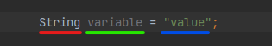
Variables
In Java, variables are declared with a type which denotes how it is stored in memory
Types go before the variable name, as such:
Red = type
Green = variable name
Blue = value stored within that variable

Slide 4
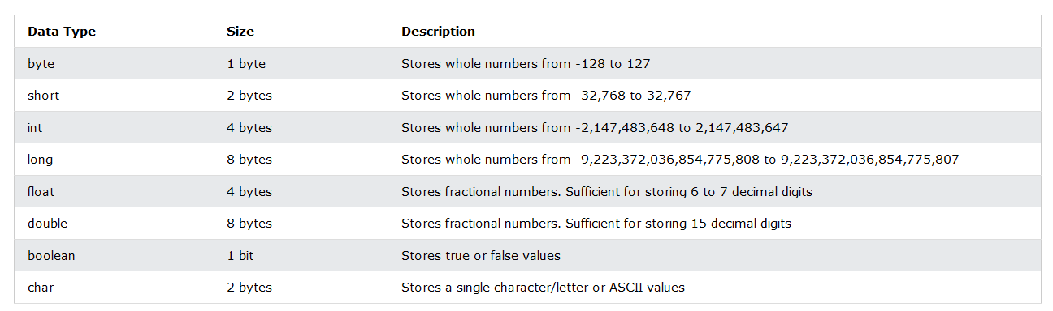
Data types
Primitive Data Types
Source: https://www.w3schools.com/java/java_data_types.asp
Notes:
---------------------------→ PAUSE TIL KL 14:10 ←--------------------------------

Slide 5
Data types
What is a primitive data type?
Data types already defined within Java
What is the difference between primitive and non-primitive data types?
Primitive | Non-primitive
Already defined by Java | Usually created by the programmer
Always has a value (not null) | Value can be null
Starts with a lowercase letter | Starts with an uppercase letter
Size in memory depends on the type | Size is the same
Source: https://www.w3schools.com/java/java_data_types.asp

Slide 6
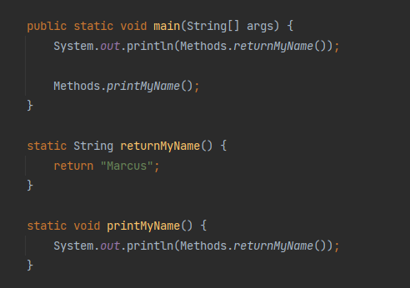
Methods
In Java, methods can be seen as functions defined within a class
A class in Java have methods and serves as a piece of code that can be run when called upon
All methods must have a return type, void if no expected return value
Example:

Slide 7
Scope
Method scope
Variables defined within a method are available only within that method, and can only be used by code that is:
Below the variable declaration
While still within the method
Block scope
Variables defined between a block of code between { and }
Can exist on its own
Can also exist as a part of an if-statement

Slide 8
Control Statements
if (condition) { … }
if (condition) { … } else { … }

Slide 9
Control Statements
String role = "student"; switch(role) { case "student": … break; case "teacher": … break; default:
…
}

Slide 10
Where can I find more information?
https://www.w3schools.com/java/default.asp
Great place to start, functions as both a tutorial and reference material
The repository for the course will be updated throughout the dayafter this lecture with tasks and exercises

